Slide 1


Slide 2
What?
MATCH is a newly designed, statewide, population health survey developed in partnership with multiple bureaus across the WV DHHR.
MATCH’s aim is to obtain better statewide and county estimates on health, health behaviors, and healthcare access.
Why?
Better health data are needed to ensure that resources are directed
to the regions and counties that need it most.
Current federal health surveys are not collecting the needed information or not obtaining accurate estimates, compared to what
is being observed statewide in Medicaid claims data and clinical observations.

Slide 3

Who/what group are we presenting to today?
Why are we presenting today?
What do we want them to do?
What do we want them to know?
MORE

Slide 4
Goal and Purpose
GOAL
PURPOSE
Improve the health of our
community and change healthcare
in West Virginia for the better.
To match community health needs with resources specifically designed to meet those needs.

Slide 5
MATCH
Mountain State Assessment of Trends in Community Health
Who is Involved
Why Should I Participate
Other Benefits
The MATCH is a partnership between the WV DHHR (Bureaus for Medical Services, Behavioral Health, Children and Families, and Public Health) and WVU Office of Health Affairs
Data collected from the MATCH will be available for local health departments, non-profits, and other organizations to access.
Your community. Your voice.
Local voices = Statewide change
Data collected from the MATCH will:
Ensure that health resources are directed to WV communities most in need
Improve and expand health services to communities across WV

Slide 6


Survey Planning
Apr 2020 – Jan 2021
Survey Development
Feb 2021 – Jul 2021
Survey Fielding
Aug 2021 – Jan 2022
Survey Timeline

Slide 7




Data Analysis and Sharing Survey Results
Data collected from the MATCH will be available to community through a variety of channels
Web Query Tool
Regular Reporting
Data Requests by Phone
or Email
Allow users to explore
de-identified MATCH data
for specific topics, geographic areas, or create their own data sets.
Survey analysis reports, summary reports, and fact sheets will be published and available on the MATCH website (WVMATCHSurvey.org)
MATCH hotline and email address available to receive and process advanced data requests.
Notes:
Data Analysis will begin in February 2022, which will include:
Survey Methodology report
Survey Data Package
Validity Testing
Survey Result Report
Data will be available to the public beginning June 2022.
Data Requests by Phone and Mail:
MATCH hotline 304-581-1928
MATCH email WVMATCHsurvey@hsc.wvu.edu
Contact information will also be displayed later in the presentation.

Slide 8


Survey Overview
Biennial survey cycle
104 questions
Approximately 20-30 minute interview
22,000 targeted sample size
88,000 starting sample size
1 in 14 West Virginias will receive an invitation to complete the survey
MORE
Notes:
Aiming for 270 completed interviews per county.
Launching a robust communication plan that includes traditional media, social media, and community mobilization to facilitate a high response rate.

Slide 9


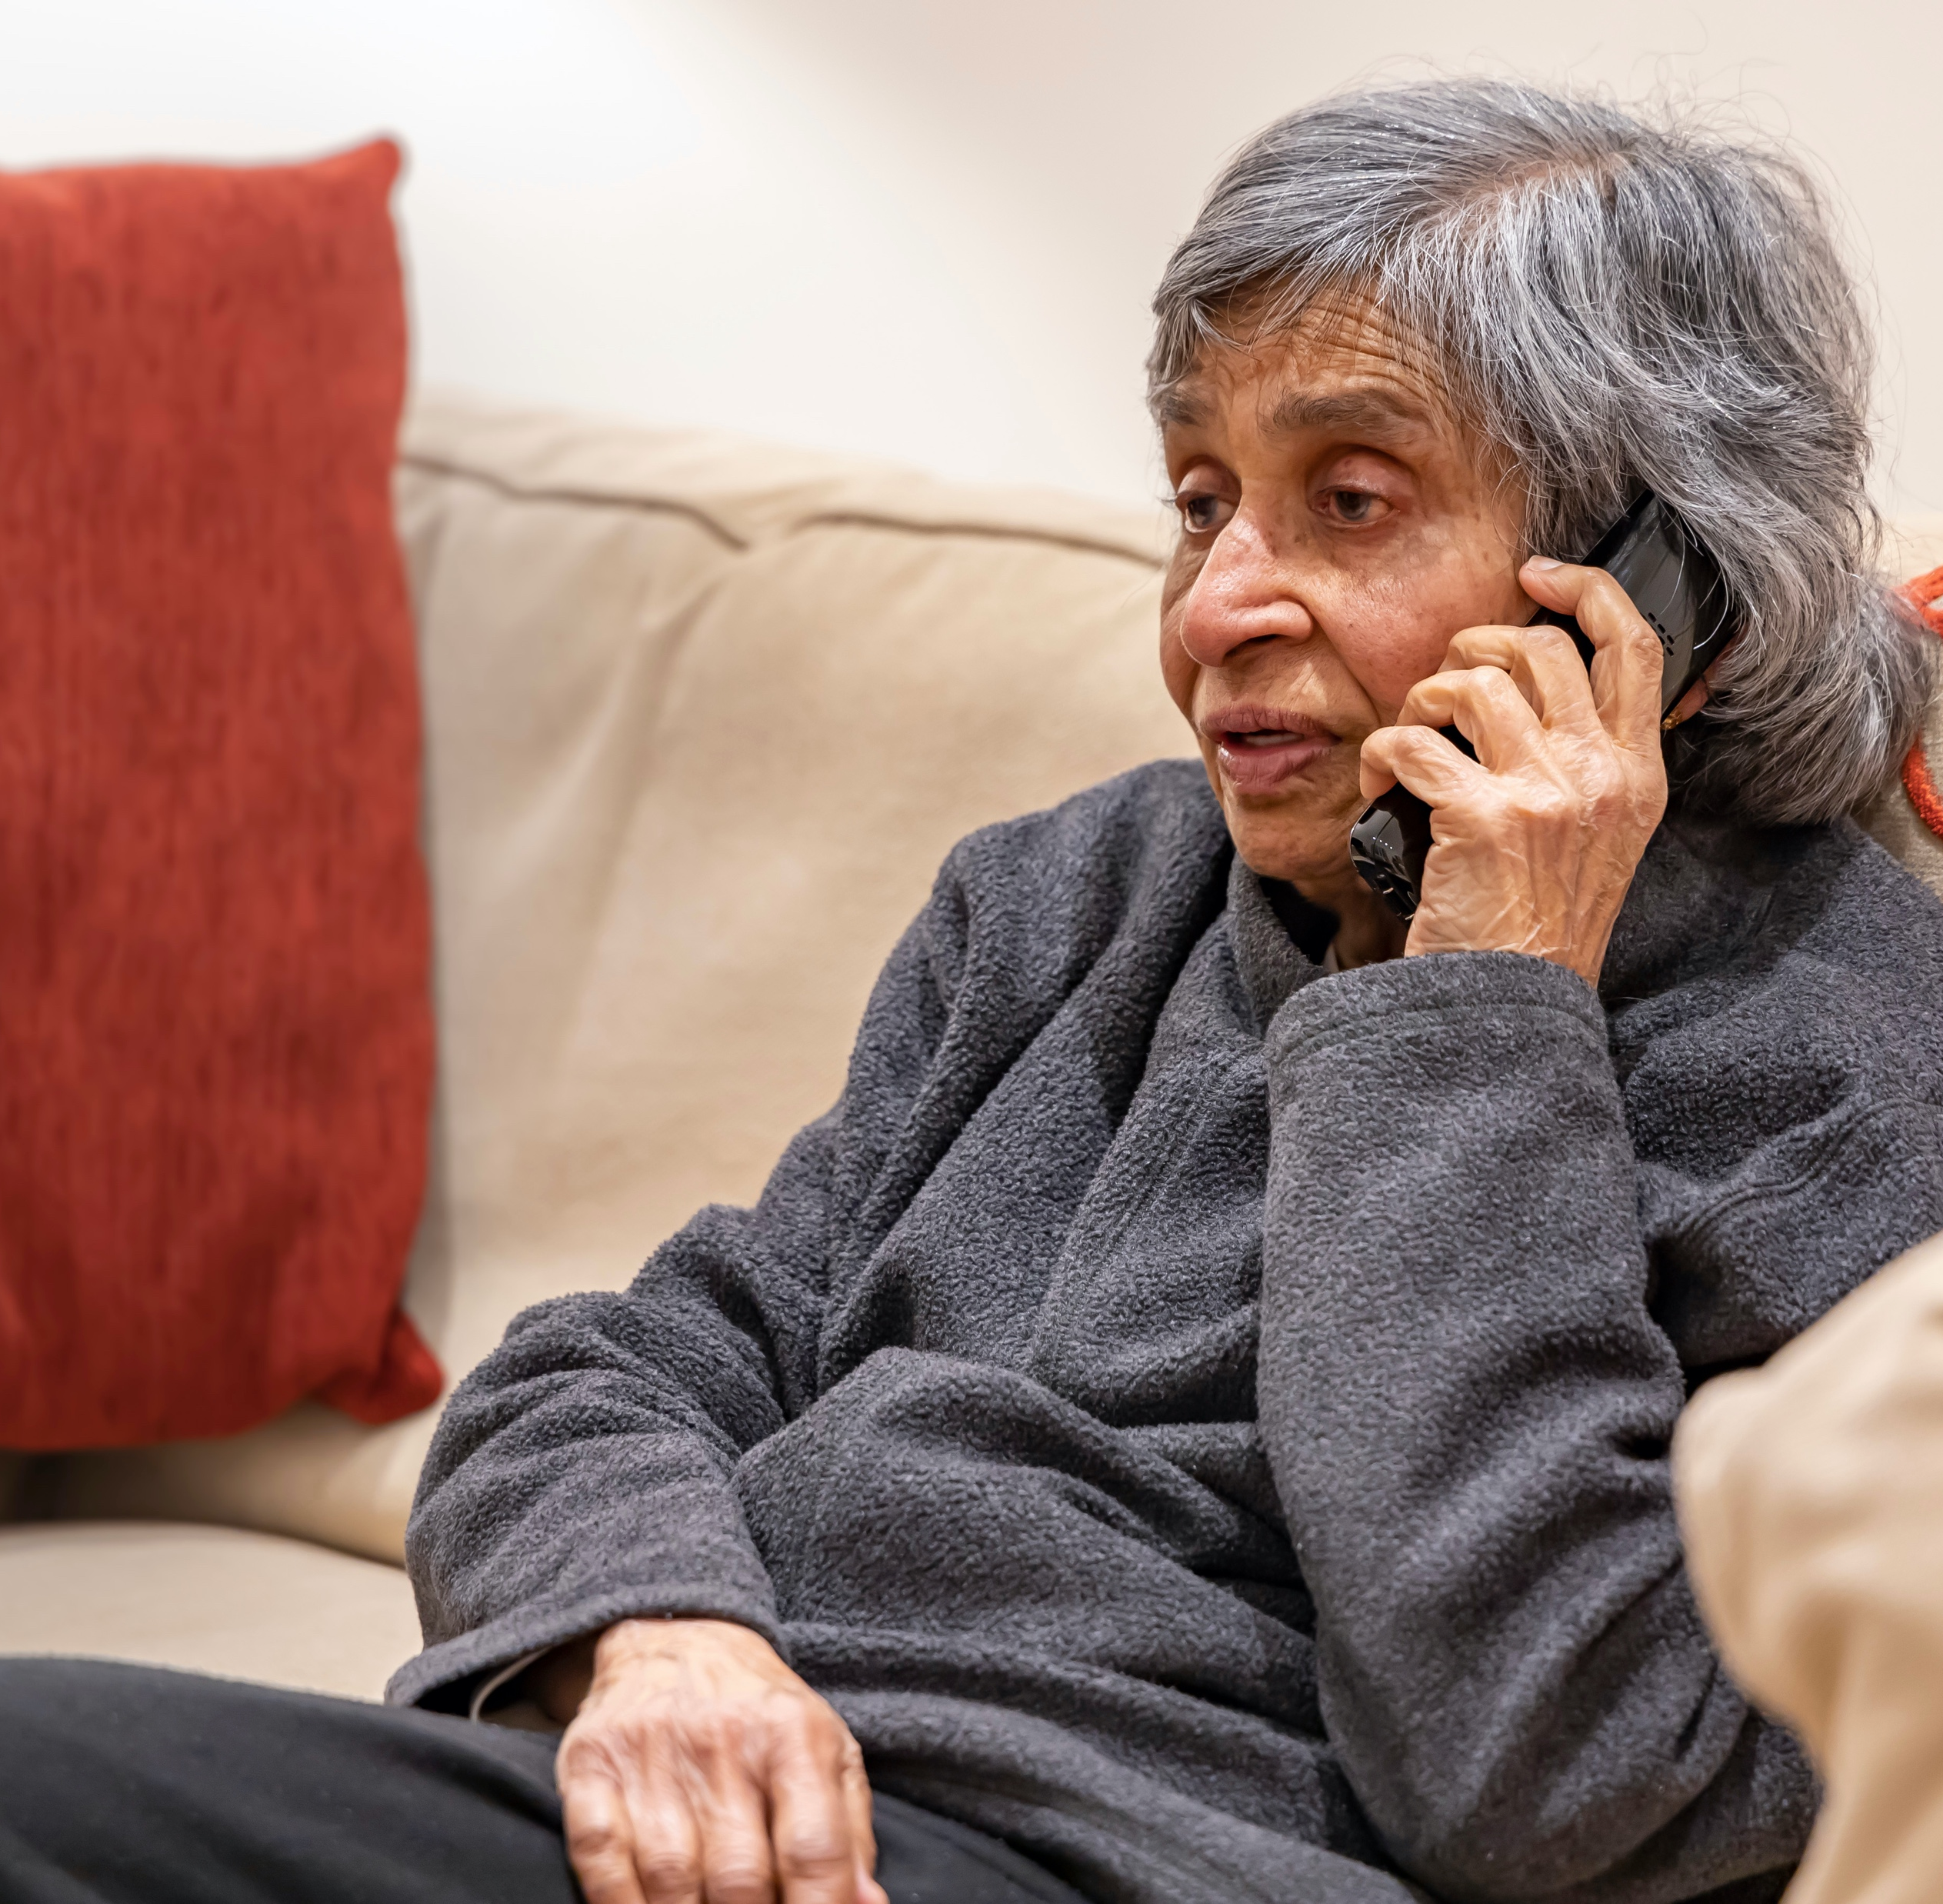
What to Expect if You are Selected
If selected, you will receive a letter in the mail inviting you to complete the survey in one of three different ways.
ONLINE SURVEY
PAPER SURVEY
PHONE INTERVIEW
Secure online portal accessible by any computer or smart device.
A traditional survey mailed to your home that you complete and mail back to us.
Complete the survey over the phone with a trained interviewer.

Slide 10
Protecting Your Privacy
Each person’s response to this survey is confidential.. Keeping your information confidential is a top priority for us. All identifying information such as home addresses and telephone numbers are removed from the information.
Information submitted to this survey is confidential and non-identifiable.
Taking, or not taking the survey will not change any state benefits you may be eligible to receive now or in the future.

Slide 11
Your Community!
Your Voice!
Share MATCH content on your personal social media accounts.
Please encourage friends and members of any groups you participate in to complete the survey.
Join the charge for Change! Help us disseminate the message and promote MATCH.
MORE

Slide 12
Our Contact
WVMATCHsurvey@hsc.wvu.edu
304-581-1928
www.WVMATCHSurvey.org
WVU Office of Health Affairs
405 Capitol Street, Suite 514
Charleston, WV 25301
64 Medical Center Drive
Morgantown, WV 26505

Slide 13


THANKS
For Your Participation

Slide 15

You have
health needs.
The goal of MATCH is to change health in WV for the better, but we can't do it without your help. By completing the MATCH survey, you ensure that your voice is heard. Support us in improving the health of your community!

Slide 16
Why Should I Participate?
Be a force for positive change
Provide insight to the health concerns facing your community
Improve the access to care in your community.
Ensure that resources are directed to the areas that need it most

Slide 17
How Do I Participate?
If selected, you will receive a letter in the mail inviting you to
complete the survey. You choose how to complete your survey.
ONLINE SURVEY
MAIL-IN SURVEY
PHONE SURVEY
Complete the survey on your computer, tablet, or smartphone.
A paper survey is mailed to your home that you complete and mail back to us.
Complete the survey over the phone with a trained interviewer.

Slide 18
THANKS
For Your Participation

